Slide 1


Slide 2

The History of Business Strategy: An NLP Perspective
A natural-language-processing exploration of the thematic landscape of the field of Business Strategy, 1980-2020
General Assembly DSI-10 Capstone Briefing
March 13, 2020

Slide 3
Purpose and Outline.
Purpose. Describe a study of the application of Topic Analysis to published literature on Business Strategy.
Outline.
Statement of business problem.
Approach to study.
Business understanding.
Data understanding.
Data collection.
Modeling.
Model evaluation.
Future directions.

Slide 4
Statement of business problem.
Essential problem. Detect in published business-strategy literature the major themes from the topic.
Target Audience.
Business consultants.
Academic researchers.
Potential benefits.
Ability to provide more-insightful guidance to clients.
Better understanding of the body of research.
Recognition of opportunities to apply methods to other problems.

Slide 5
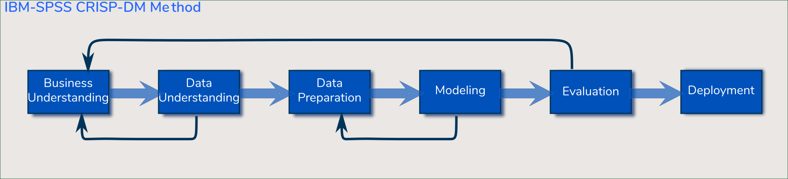
This study’s approach was guided by IBM’s CRISP-DM method.

Slide 6
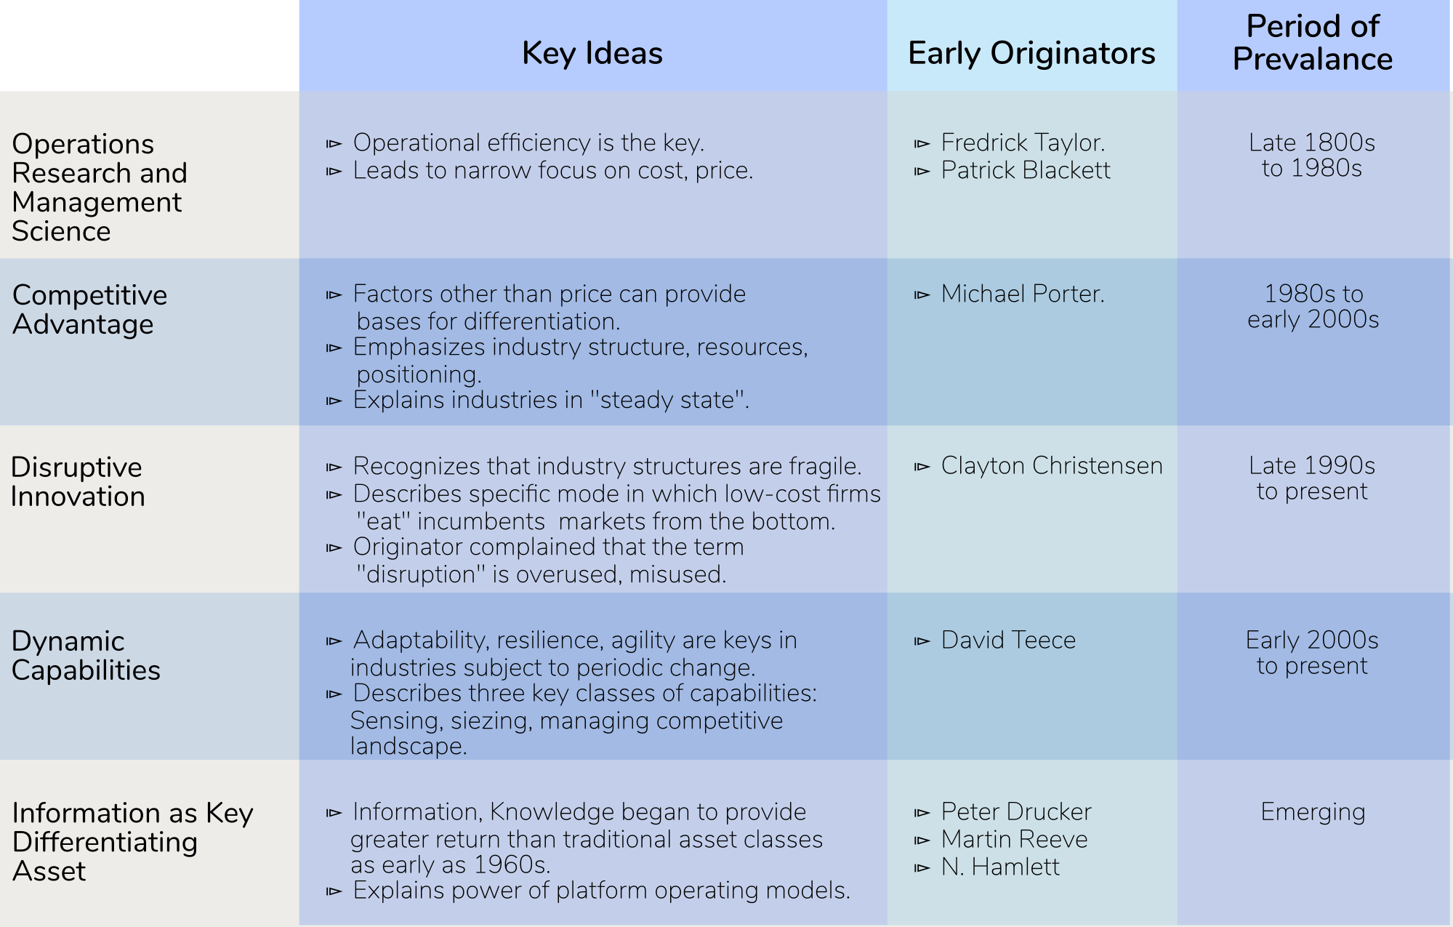
Business understanding: Five key themes dominated the business-strategy discussions over the last century.

Slide 7
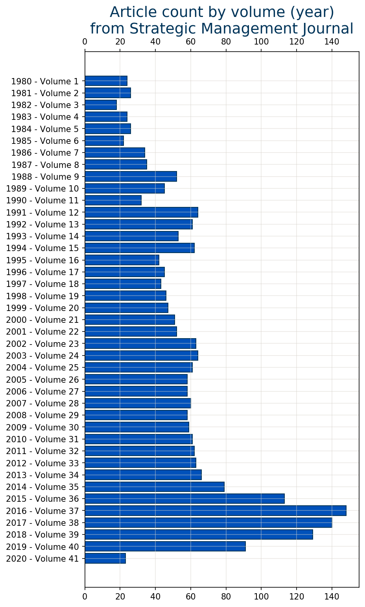
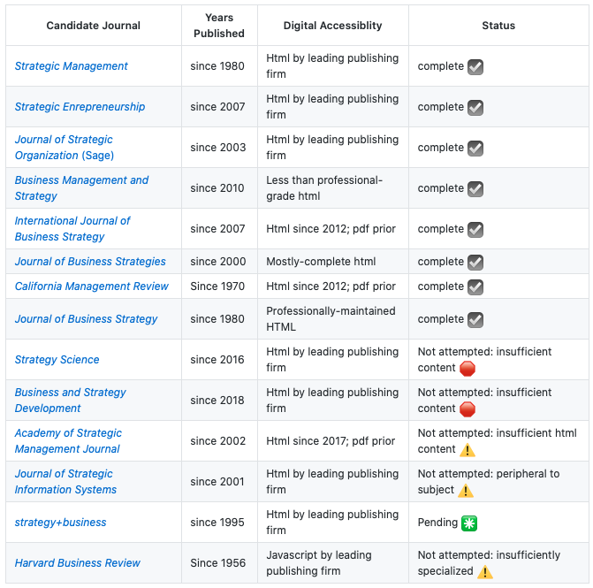
Data Understanding: The business-strategy literature is concentrated both in publications and in time.

Slide 8
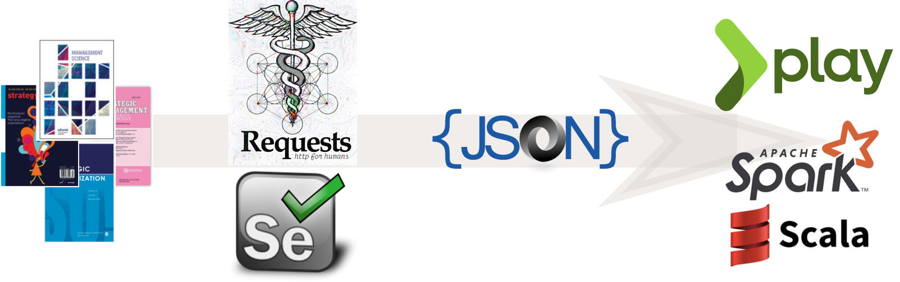
Data Preparation: A mixture of technologies and methods was employed to assemble the corpus.

Slide 9
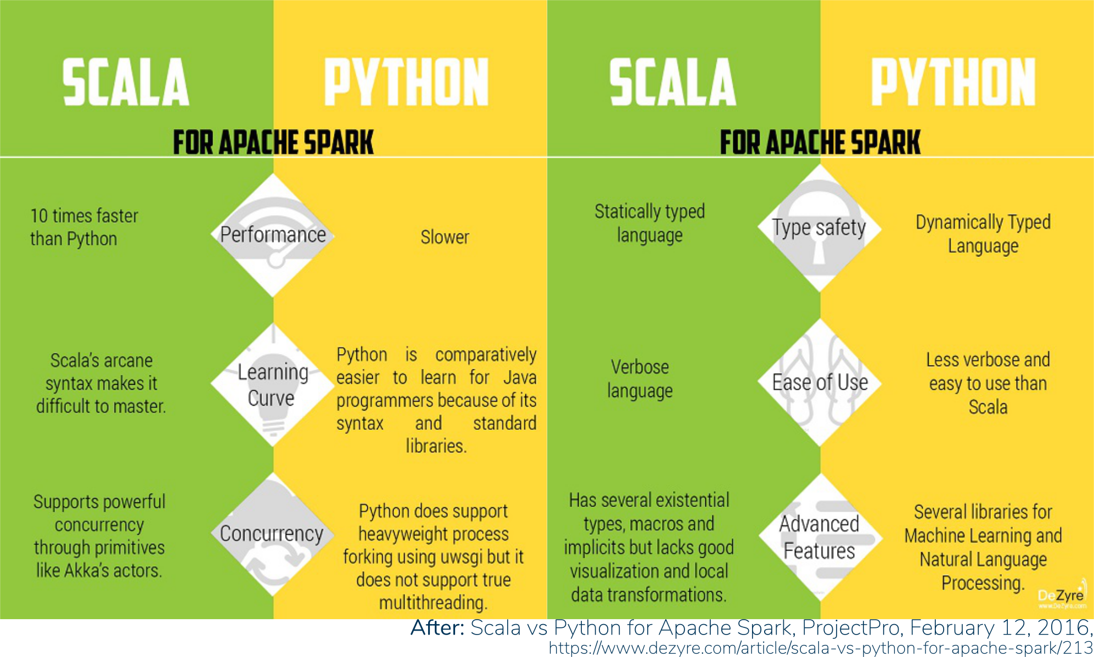
Modeling: The modeling itself was performed in Spark Scala, due to its computational-performance advantages.

Slide 10
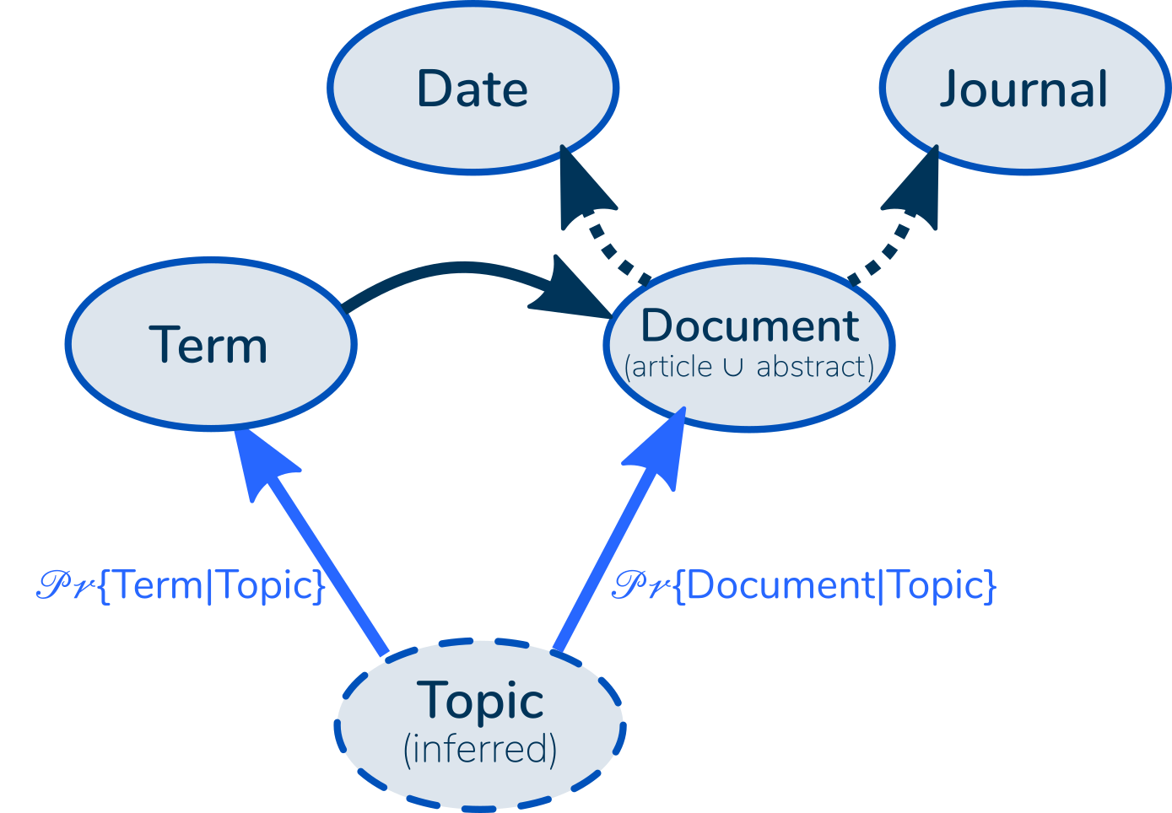
Modeling: Latent Dirichlet Allocation (LDA) — a Bayesian unsupervised-learning method — is commonly used for topic analysis.
Latent: The Topic attribute is “latent”: Not directly observable.
Dirichlet: The Topic probabilities are described by a Dirichlet probability distribution.
Allocation: We allocate our probabilities across all topics, not definitively assigning to one or another.

Slide 11
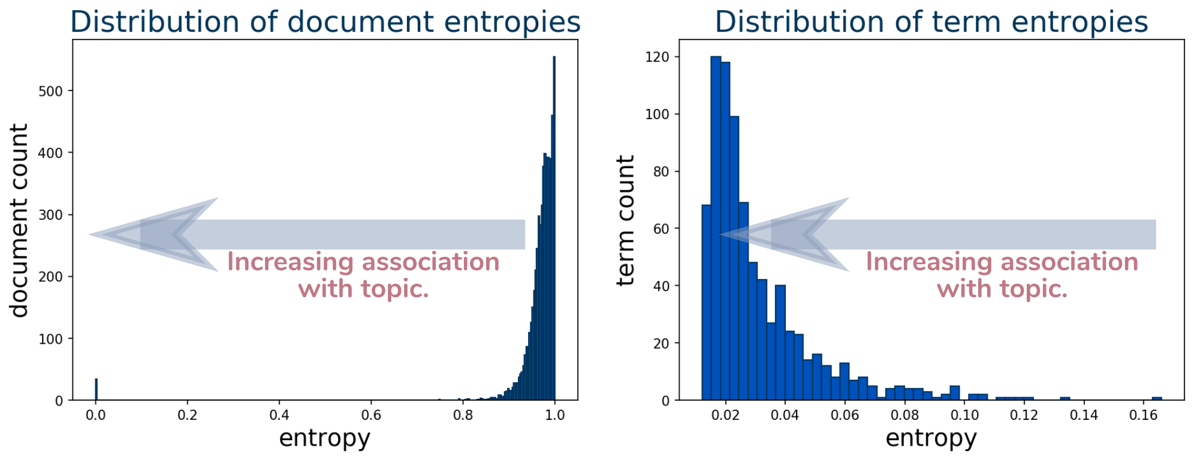
Model Evaluation: Terms (words) are more-strongly associated with topics than the documents they come from.

Slide 12
Directions of further work.
INFORMS Annual Meeting
November 2020
March 2020
Sharpen the model: Incorporate Ngrams, lemmatization.
Harvest the strategy+business journal.
Perform closer comparison between topics and major themes.
Calculate the marginal 𝒫𝓇{Topic} and calculate cluster “quality” via entropy.
Harvest full-text journal articles.
Calculate “perplexity”, statistic described in [Brie, et al, 2003], and compare with entropy.
Visualize topic clusters’ temporal variation (e.g., violin plot).

Slide 13
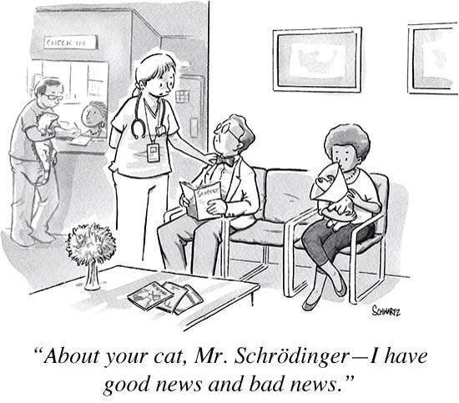
Questions?

